Slide 1
Capstone Project
STOCK TRADING AND INVESTMENT PERFORMANCE ANALYTICS SYSTEM
PRESENTED BY
SAKETH KARUMUDI
email id: sakethkarumudi@gmail.com
VNR VIGNANA JYOTHI INSTITUTE OF ENGINEERING AND TECHINOLOGY

Slide 2

BUSINESS CONTEXT
Financial markets generate large volumes of time-series data that must be analyzed efficiently to support trading and investment decisions.
However, organizations often face:
  Fragmented raw data stored in flat files
  Manual and non-scalable analysis processes
  Limited visibility into portfolio performance
  Inconsistent measurement of returns and risk
Business Requirement:
A centralized, automated analytics platform to process market data and deliver actionable insights.

Slide 3
PROBLEM STATEMENT AND OBJECTIVES
The organization requires a centralized analytics system that can:
  Automatically process stock market data
  Analyze trading and investment performance
  Measure returns, volatility, and trends
  Provide business-ready insights through dashboards
The system must be scalable, reliable, and automated.

Slide 4
PROBLEM STATEMENT AND OBJECTIVES
The objectives of this project are to:
  Build an automated pipeline for stock market data
  Clean, validate, and standardize financial datasets
  Perform market, company, and portfolio analytics
  Enable scheduled and monitored data workflows
  Deliver insights through interactive Power BI dashboards

Slide 5




TECH STACK
Data Processing & Analytics
  Python for ingestion and preprocessing
  Pandas for time-series analysis
  PySpark for large-scale transformations
Platform & Tools
  Databricks for distributed processing
  Apache Airflow for orchestration
  Power BI for visualization
  GitHub for version control

Slide 6
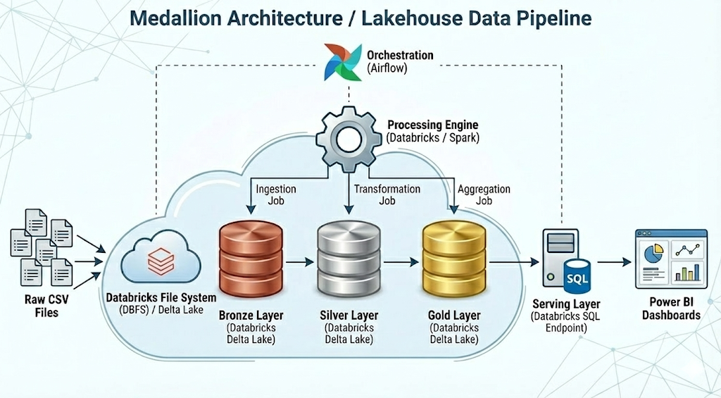
ARCHITECTURE DIAGRAM
Design Approach
  Layered architecture
  Separation of concerns
  Analytics-ready data models

Slide 7
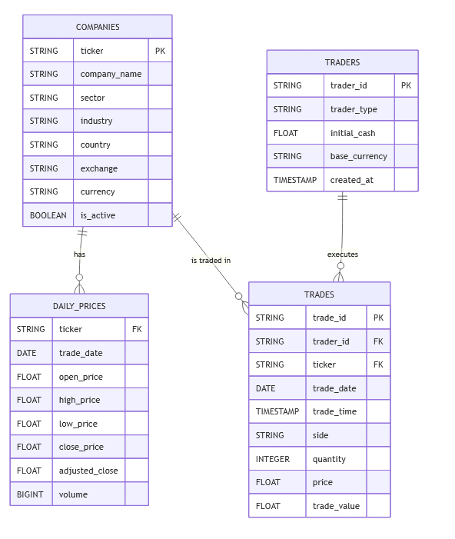
DATA SCOPE
Datasets Used
  Company master data
  Daily stock prices (OHLCV)
  Traders and trade transactions
  Foreign exchange rates
Data Characteristics
  Historical and incremental
  Time-series based
  Multi-currency

Slide 8

BRONZE LAYER - DATA INGESTION
What Was Done
  Raw CSV files were ingested into the system
  Both historical and daily incremental data were supported
  Metadata was added to track:
    Ingestion time
    Data source
    Load type
Outcome
A reliable raw data foundation with full traceability.

Slide 9

SILVER LAYER - DATA QUALITY AND VALIDATION
What Was Done
  Data types were standardized (dates, prices, volumes)
  Invalid records were identified:
    Missing values
    Negative prices or quantities
  Duplicate records were removed
  Referential integrity was enforced across datasets
Outcome
Clean, consistent, and trustworthy datasets for analytics.

Slide 10

DATA QUALITY MANAGEMENT
Quality Handling
  Invalid records were not deleted
  They were moved to dedicated reject tables
Benefits
  Full auditability
  Transparency in data quality issues
  Improved trust in analytical results
This approach reflects real-world enterprise data governance practices.

Slide 11

GOLD LAYER - FINANCIAL ANALYTICS
What Was Built
  Market-level performance metrics
  Company-level price and return analysis
  Trader portfolio performance tracking
  Sector and long-term trend analysis
Analytics Examples
  Daily returns
  Moving averages
  Volatility measures
  Profit and loss calculations

Slide 12

WORKFLOW AUTOMATION
Automation Design
  Apache Airflow schedules the end-to-end pipeline
  Each Airflow DAG:
    Triggers Databricks notebooks/jobs
    Manages dependencies (Bronze → Silver → Gold)
    Handles retries and failures
Outcome
A production-style, fully automated analytics workflow.

Slide 13
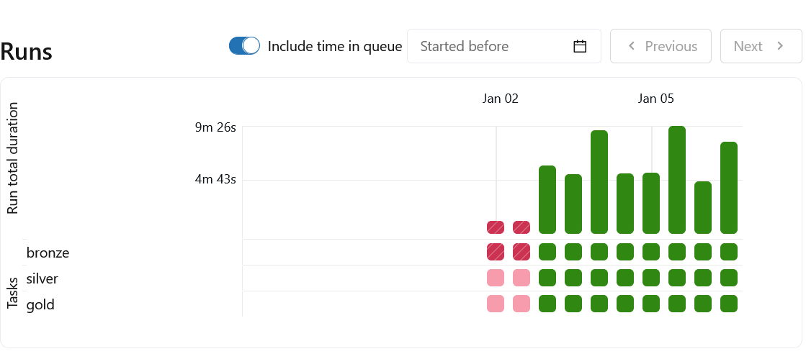
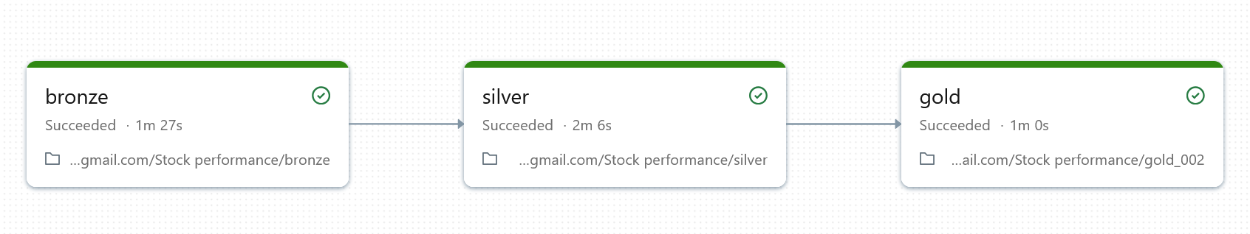
WORKFLOW AUTOMATION

Slide 14
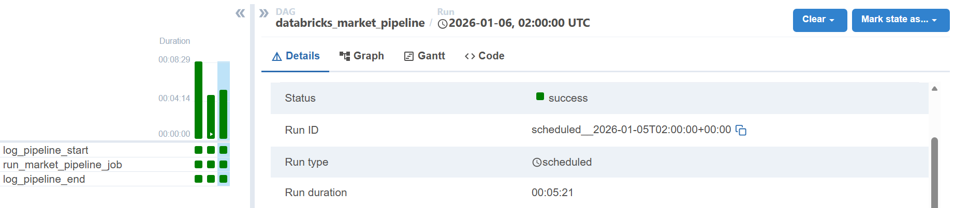
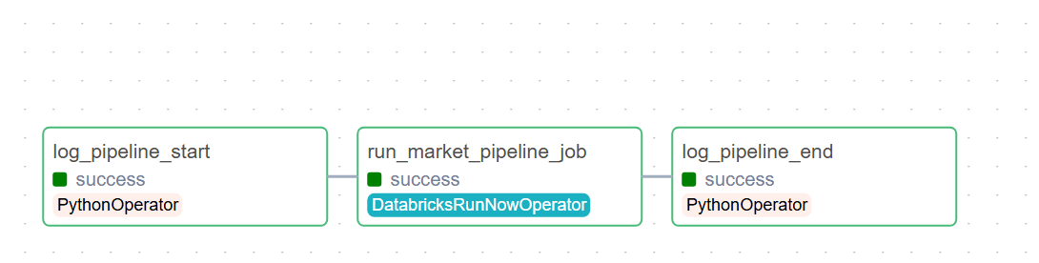
WORKFLOW AUTOMATION

Slide 15
POWER BI DASHBOARDS
Dashboards Delivered
  Market Overview
  Company Performance
  Trader Portfolio Performance
  Sector and Trend Analysis
Features
  KPI cards
  Interactive filters
  Time-based trends
  Drill-down analysis
Business Use Cases Answered
  Track overall market trends and risk
  Identify high-performing and underperforming stocks
  Evaluate trader profitability
  Compare sector performance
  Make risk-adjusted investment decisions

Slide 16
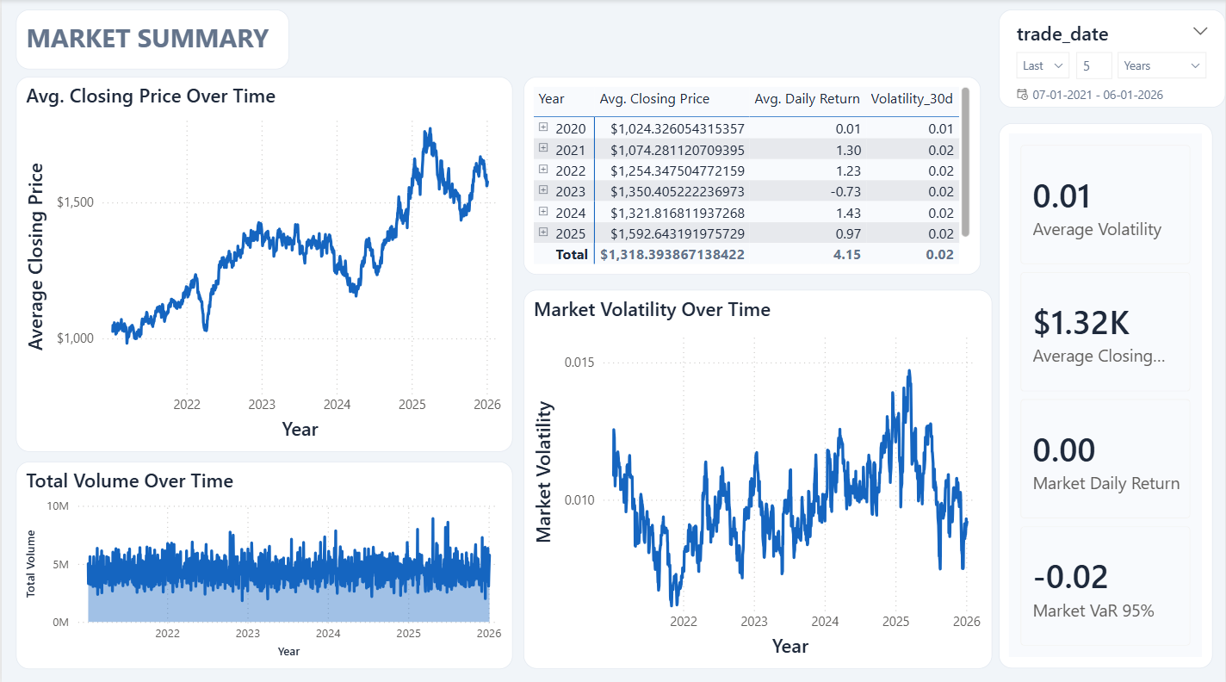
POWER BI DASHBOARDS

Slide 17
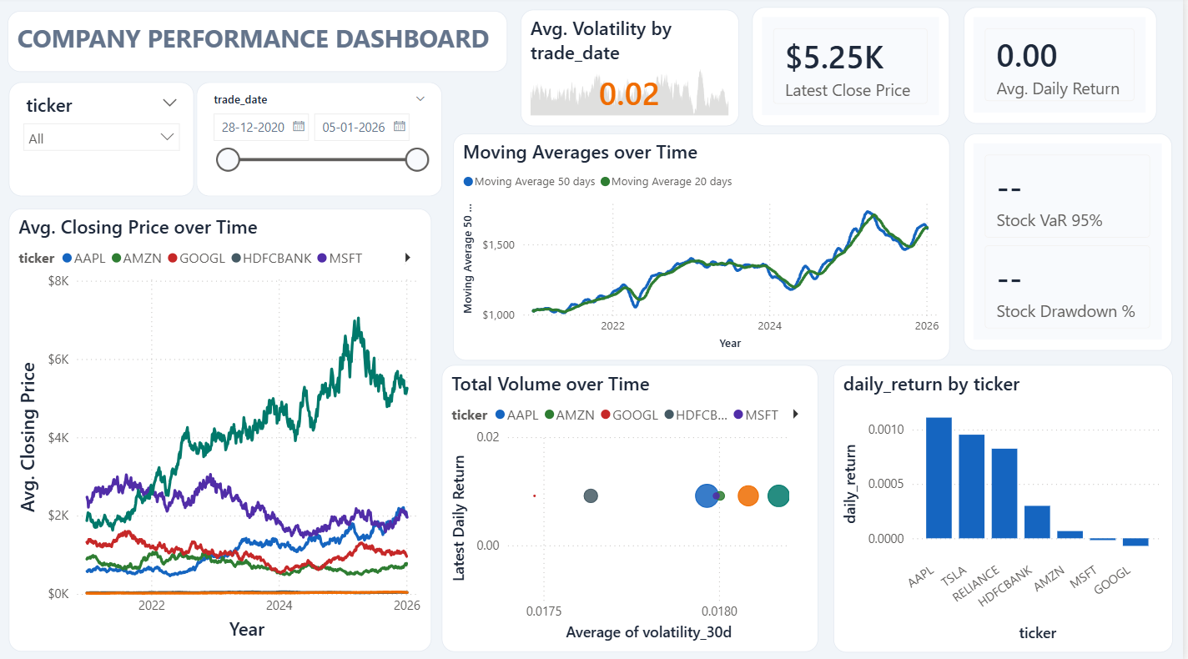
POWER BI DASHBOARDS

Slide 18
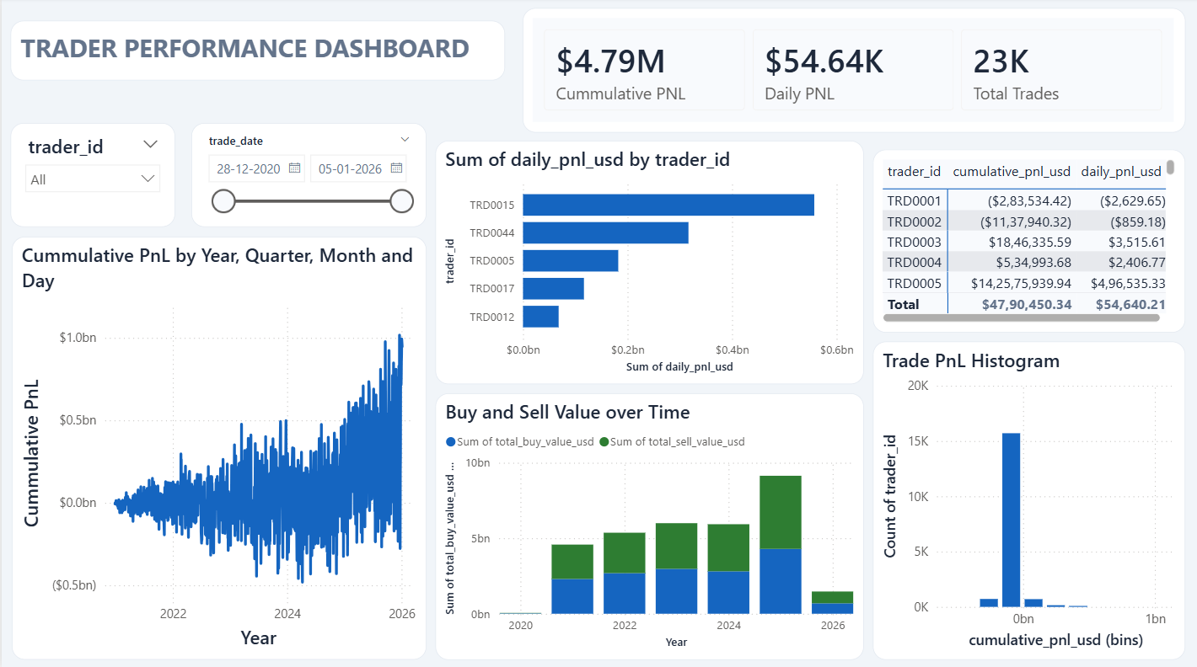
POWER BI DASHBOARDS

Slide 19
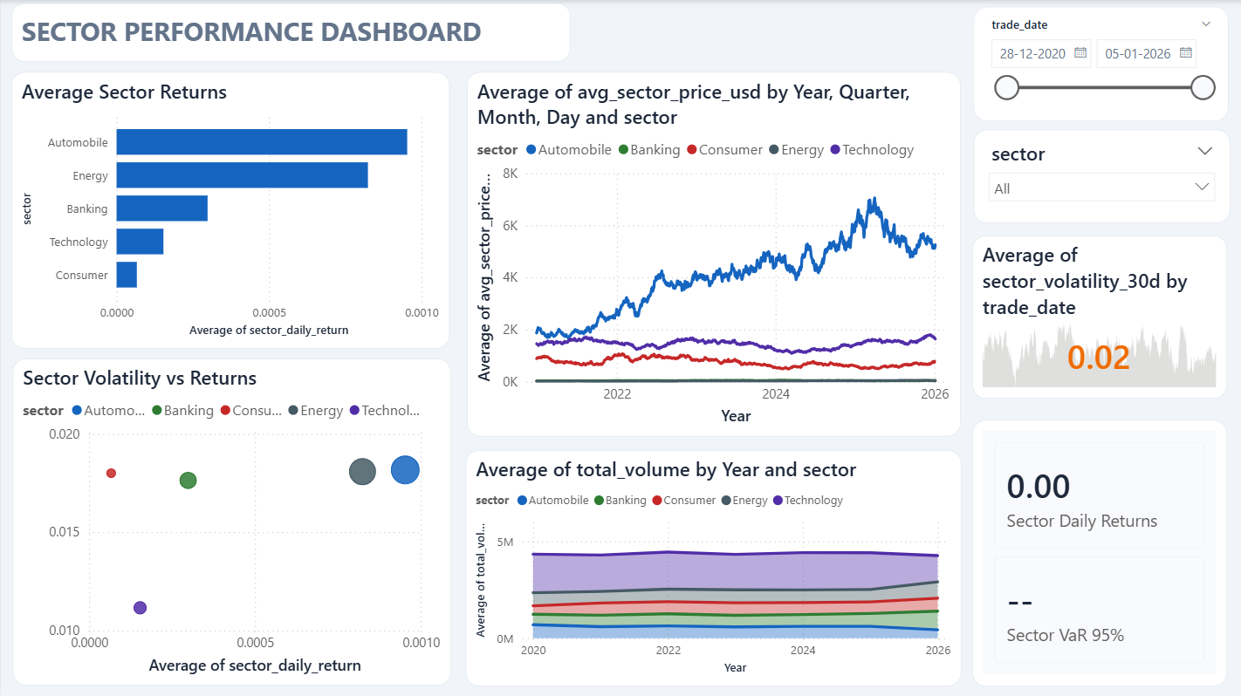
POWER BI DASHBOARDS

Slide 20
Thank You

